Slide 1
Threading, Executors, Runnables
Presented By Wayne Thomas

Slide 2
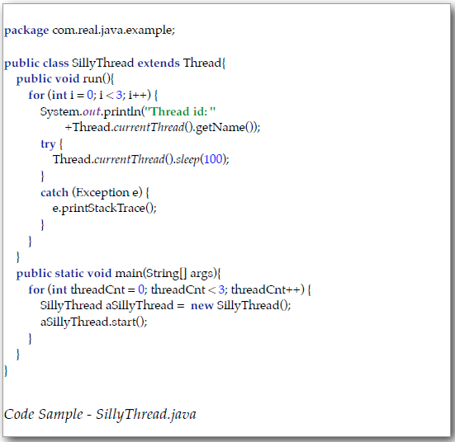
Thread Class
java.lang.Thread
One of the oldest methodologies

Slide 3
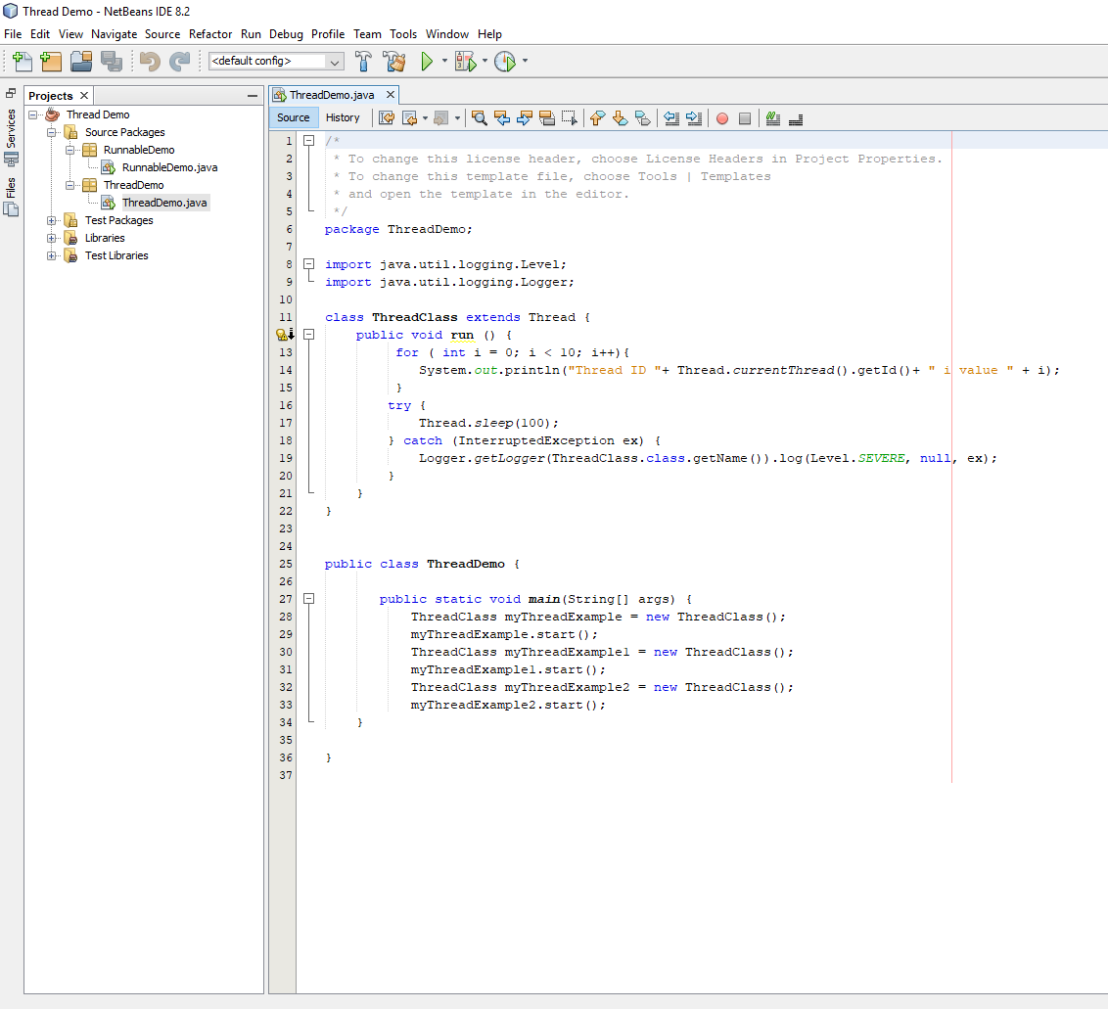
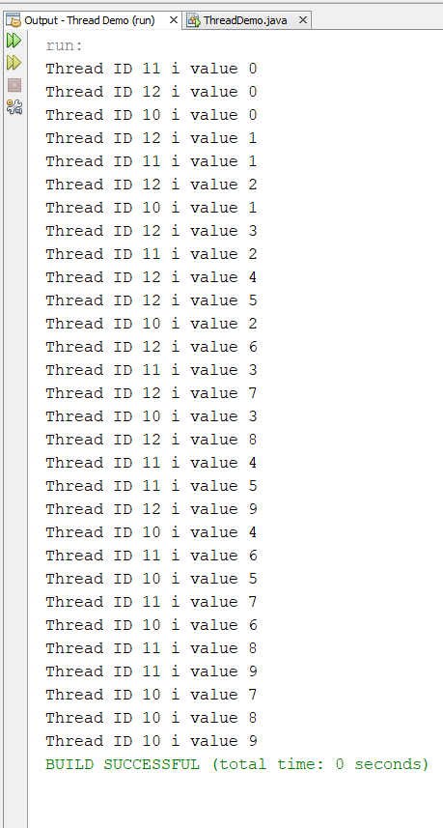
Thread Class

Slide 4
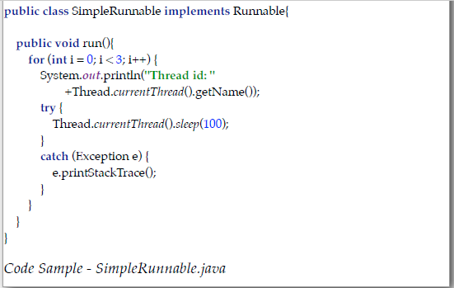
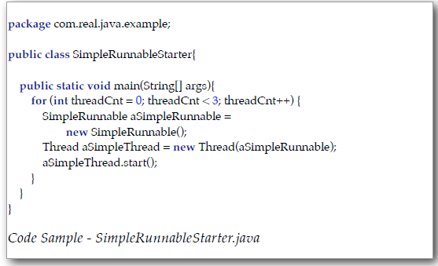
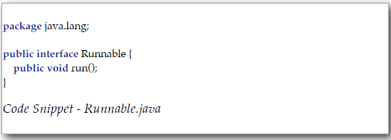
Runnable
java.lang.Runnable
More modular than Threading
Easier to create and maintain

Slide 5
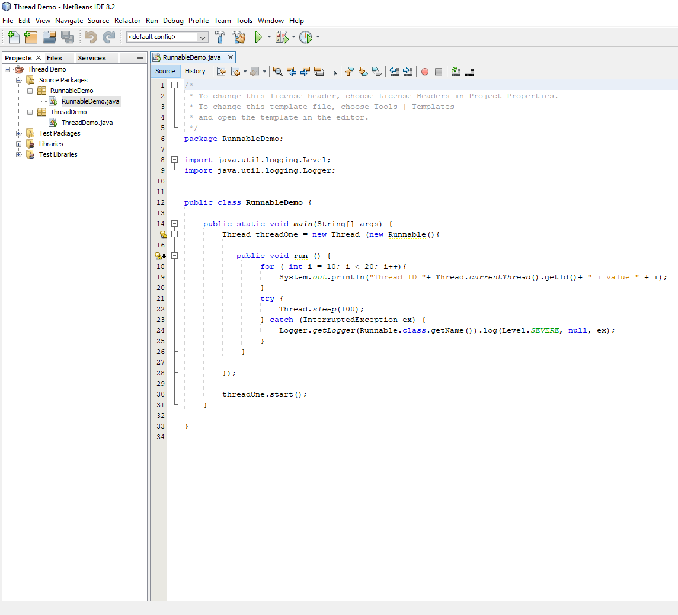
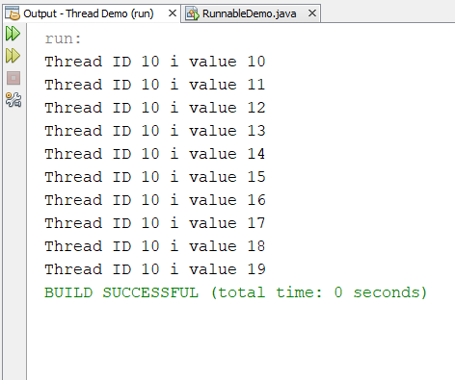
Runnable

Slide 6
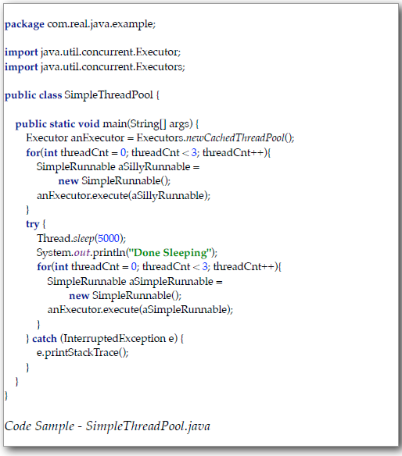
Executors
java.util.concurrent.Executors
Newest methodology to create multi-threaded applications
Utilizes thread “pools” to manage thread use

Slide 7
Executors
https://github.com/CIT360-Fall2018-Group5/SampleCode

